Slide 1
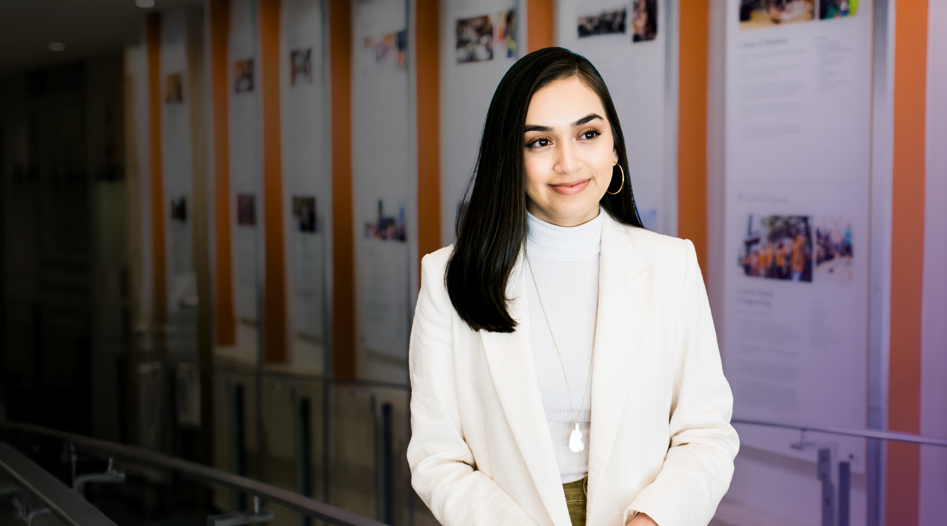

Program Overview
December 2025

Slide 2
The Dell Scholars program empowers students to reach their college and career goals.
Notes:
The Dell Scholars program is more than a scholarship. It’s a whole support system to help you navigate the academic, financial, and personal challenges of college.

Slide 3




Unlocking Potential, from College to Career
The Dell Scholars program gives students the tools and resources they need to graduate from college and build successful careers. It's more than a scholarship—our support includes:
Academic
Consistent check-ins, personalized coaching, and tailored academic planning.
Financial
Flexible support for tuition, housing, and other essentials—so you can focus on learning, not expenses.
Professional
Career guidance, networks, and hands-on experience to build skills for life after college.
Wellness
Mental health resources to build resilience, motivation, and balance in school and life.
Notes:
Benefits include a laptop, textbook credits, access to a free teletherapy service, and free online tutoring hours.
Learn more about program benefits in this video: https://www.youtube.com/watch?v=h1hlo4apAAM

Slide 4
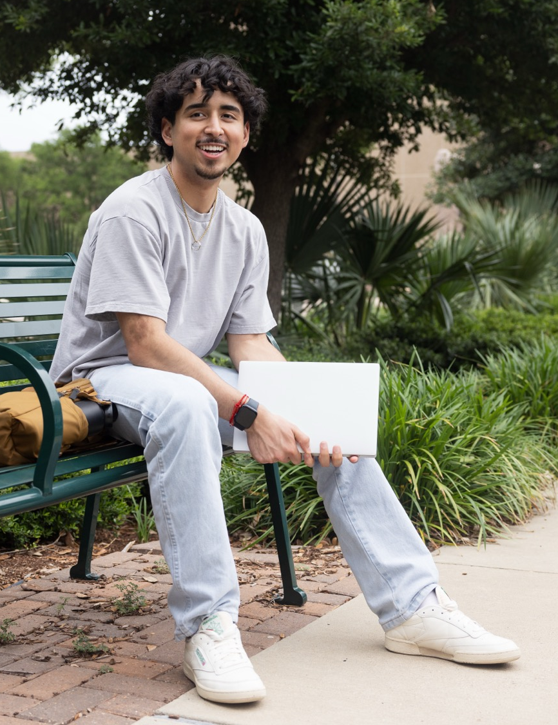

Eligibility
To apply, all students must:
Participate in a program-approved college readiness program (CRP) in grades 11 and 12
Be on track to graduate from an accredited high school in the current academic year, with a minimum of a 2.4 GPA
Demonstrate a need for financial assistance
Be eligible to receive a federal Pell Grant in first year of college
Plan to enroll full time at an approved accredited four-year higher education institution in the pursuit of a bachelor's degree in the fall directly following high school graduation
Notes:
We are strengthening our focus on students who may not have perfect grades but show perseverance and a deep commitment to their education. As you share this opportunity with your students, we encourage you to highlight it for those who reflect these qualities.

Slide 5

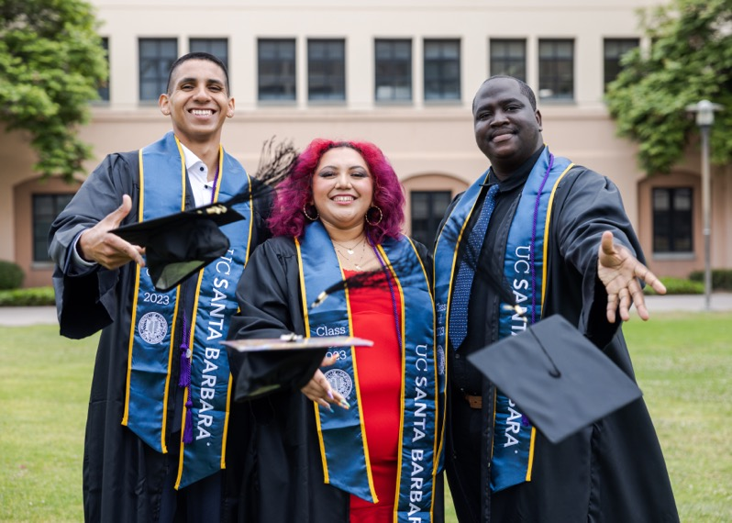
Who Should Apply?
Strong candidates demonstrate:
A strong sense of purpose – They set clear goals and take steps to achieve them.
A career-driven mindset – They see their bachelor’s degree as a stepping stone to a fulfilling career.
Perseverance – They turn obstacles into opportunities, finding ways to move forward and succeed.
Self-motivation and determination – They take initiative, seek opportunities, and keep pushing forward.

Slide 6
Key Application Dates
2025
2026
December 15
Application opens
February 15
Application deadline
The first phase of the application can be completed in only 10-15 minutes – quick and easy!
March 1
Finalists announced
May 15
Finalists’ material due
June 1
Dell Scholars announced

Slide 7
I’m a Dell Scholar
Watch Video
Notes:
Video: https://www.dellscholars.org/?wvideo=un4b58pxzl

Slide 8
The Dell Scholars program is here to support students just like you to achieve your college ambitions.
Complete your application by February 15.

